Slide 1
Join The Slack Workspace
https://bit.ly/2Ve9DwB
Join The Raffle (in general channel)
/raffle 6 enter

Slide 2
BU
Policies, Standards,
Ref Archi
Guardrails
Controls
150-Page Solution Design
Policies, Standards, Ref Archi
Config Drift Detection
Auto-response
Controls
Guardrails
Security Review, Risk Assessment
Playground
Guardrails
BU
Guardrails
Pentest
Production
Guardrails

Slide 3
{code}, code.tf etc.
“If” : {
“type” : “code”,
“notEquals” : “baseline”
},
“then” : {
“action” : “auto fix”
}
3
Security Patterns
Common Controls
2
You Shall
You Must
You Must Not
Reference
Architecture
1

Slide 4
Azure Key Vault
Subnets
Must have IP whitelisting or Virtual Network
Must be integrated with Log Analytics Workspace
Log Analytics Workspace must be integrated with Azure Monitor -> SIEM
Default Access Policies must not have “delete” permission
All subnets must have “route” UDR to force tunnel internet traffic to virtual appliance
All subnets must have default NSG attached

Slide 5
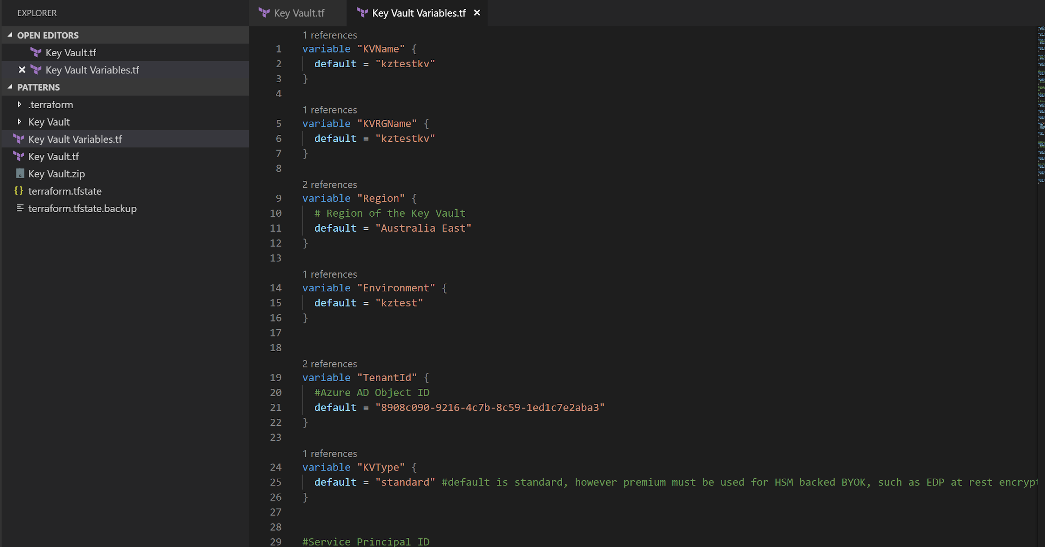
Key Vault Pattern.tf

Slide 6
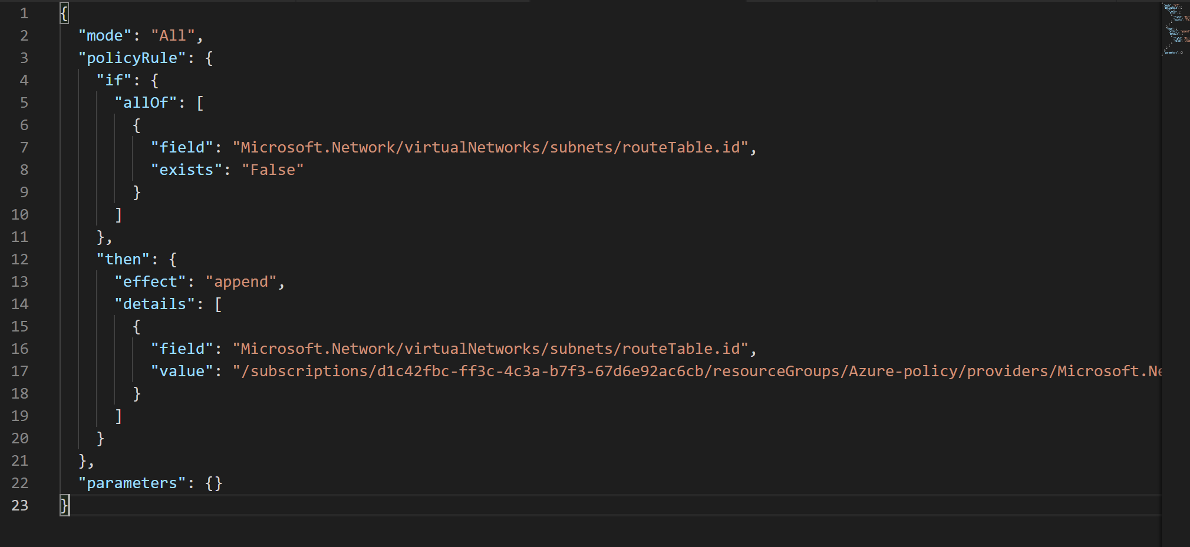
Auto Apply RouteTable

Slide 7
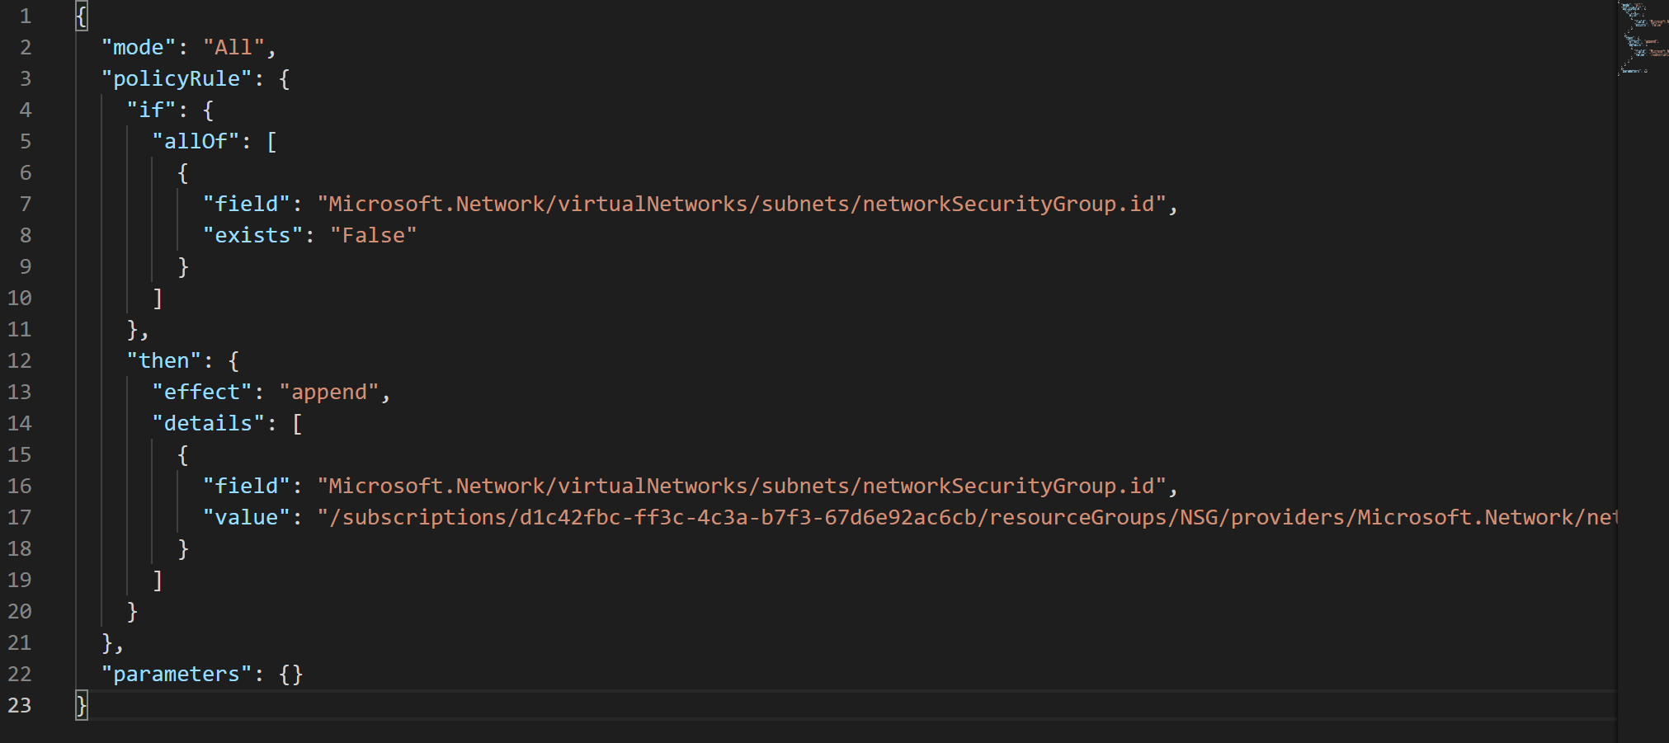
Auto Apply NSG

Slide 8
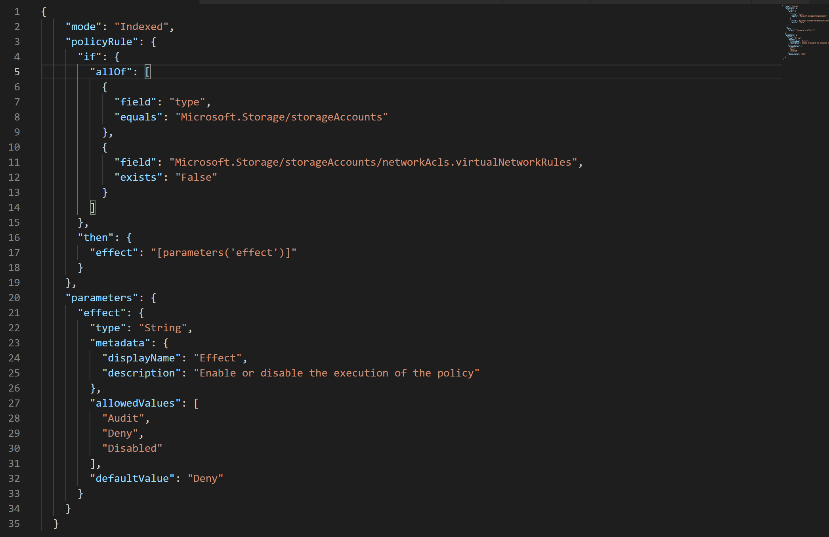
Deny Storage Account Without Assigning Virtual Networks

